Slide 1
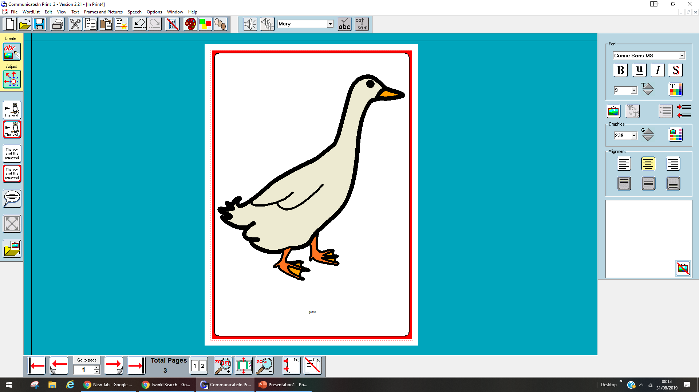
Silly Suzy goose
Wanted to be different

Slide 2
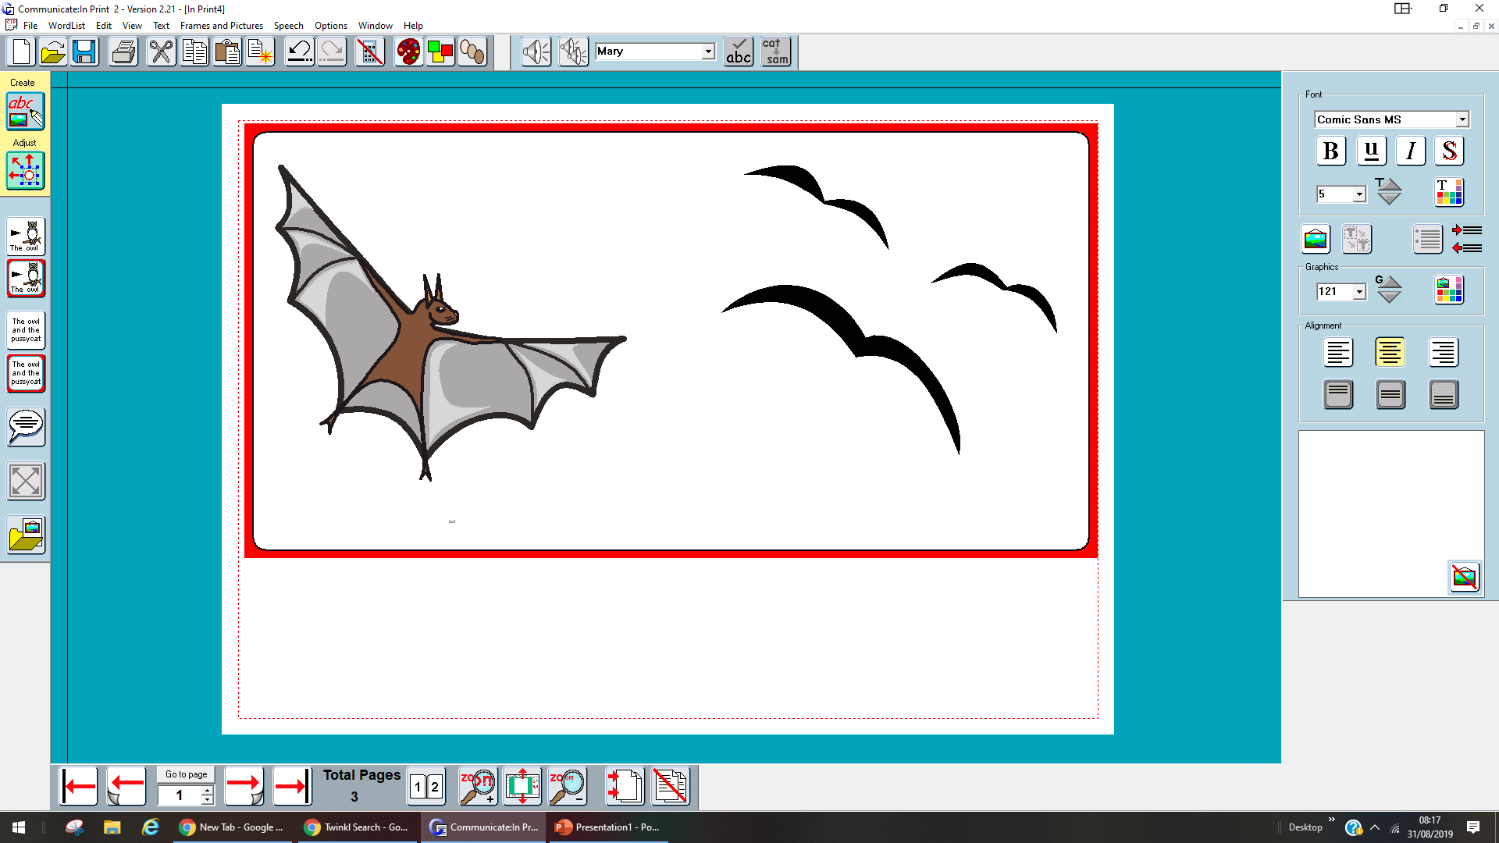
I want to be a bat flap flap

Slide 3

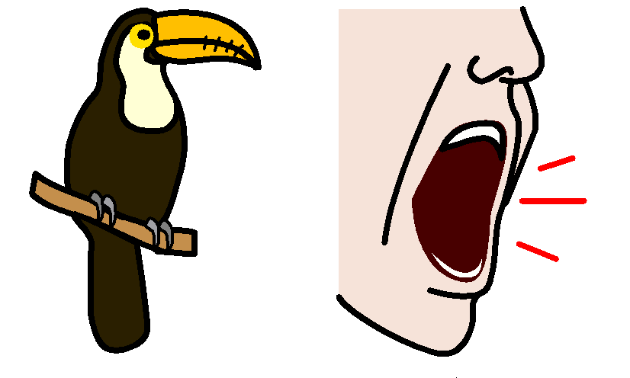
I want to be a toucan squawk

Slide 5
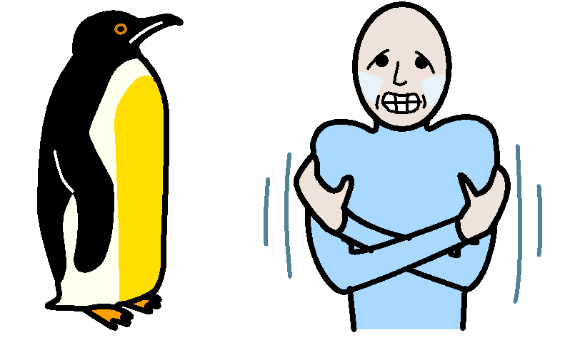
I want to be a penguin cold

Slide 6
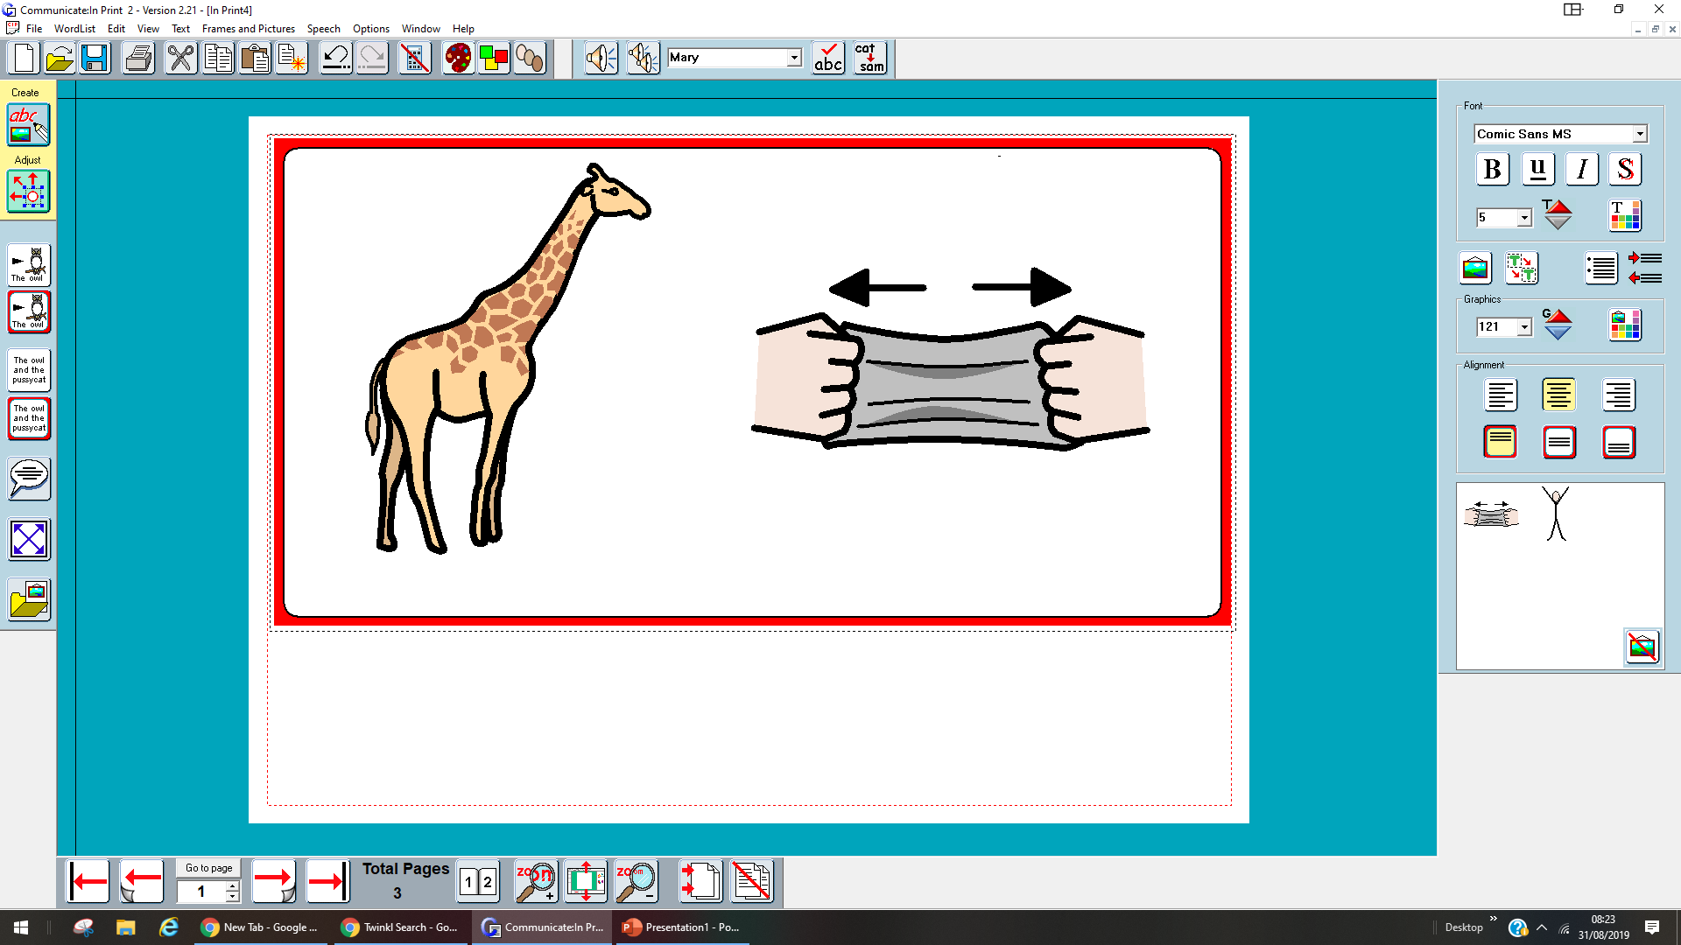
I want to be a giraffe stretch

Slide 7
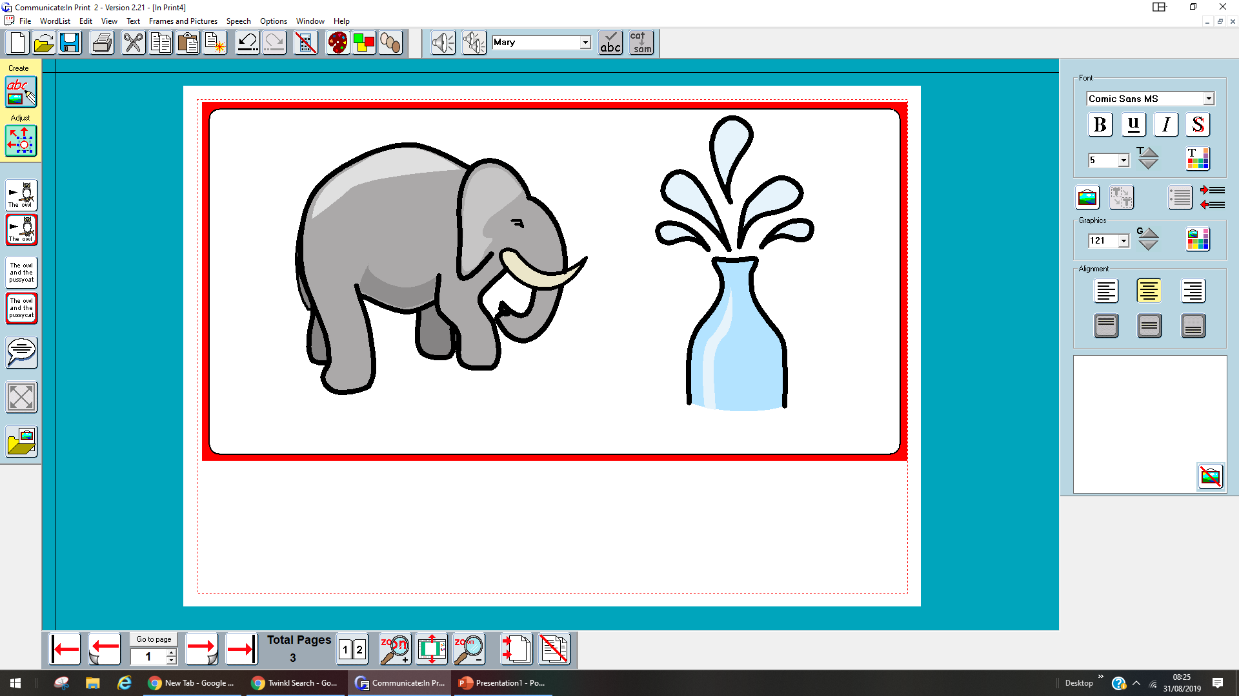
I want to be an elephant squirt

Slide 8
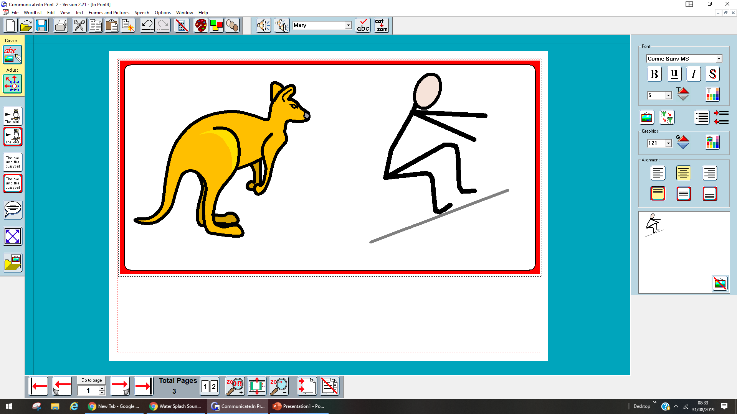
I want to be a kangaroo jump

Slide 9
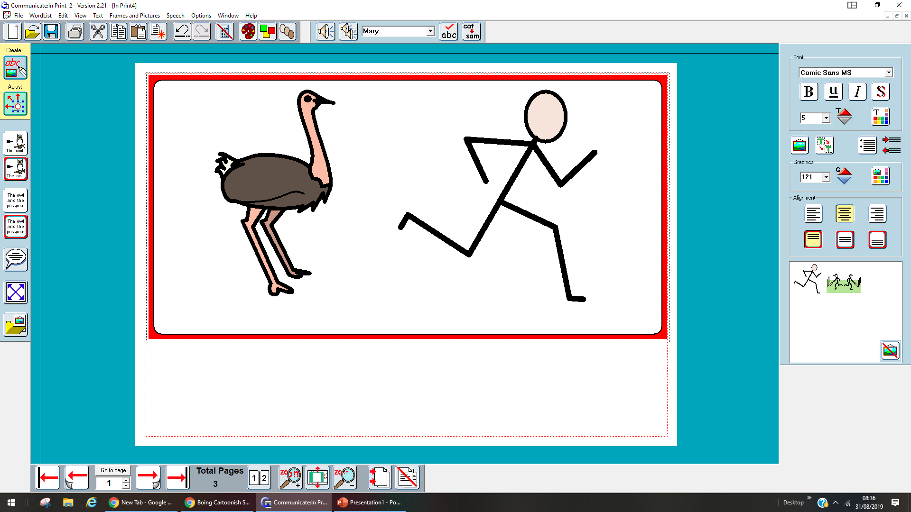
I want to be an ostrich run

Slide 10
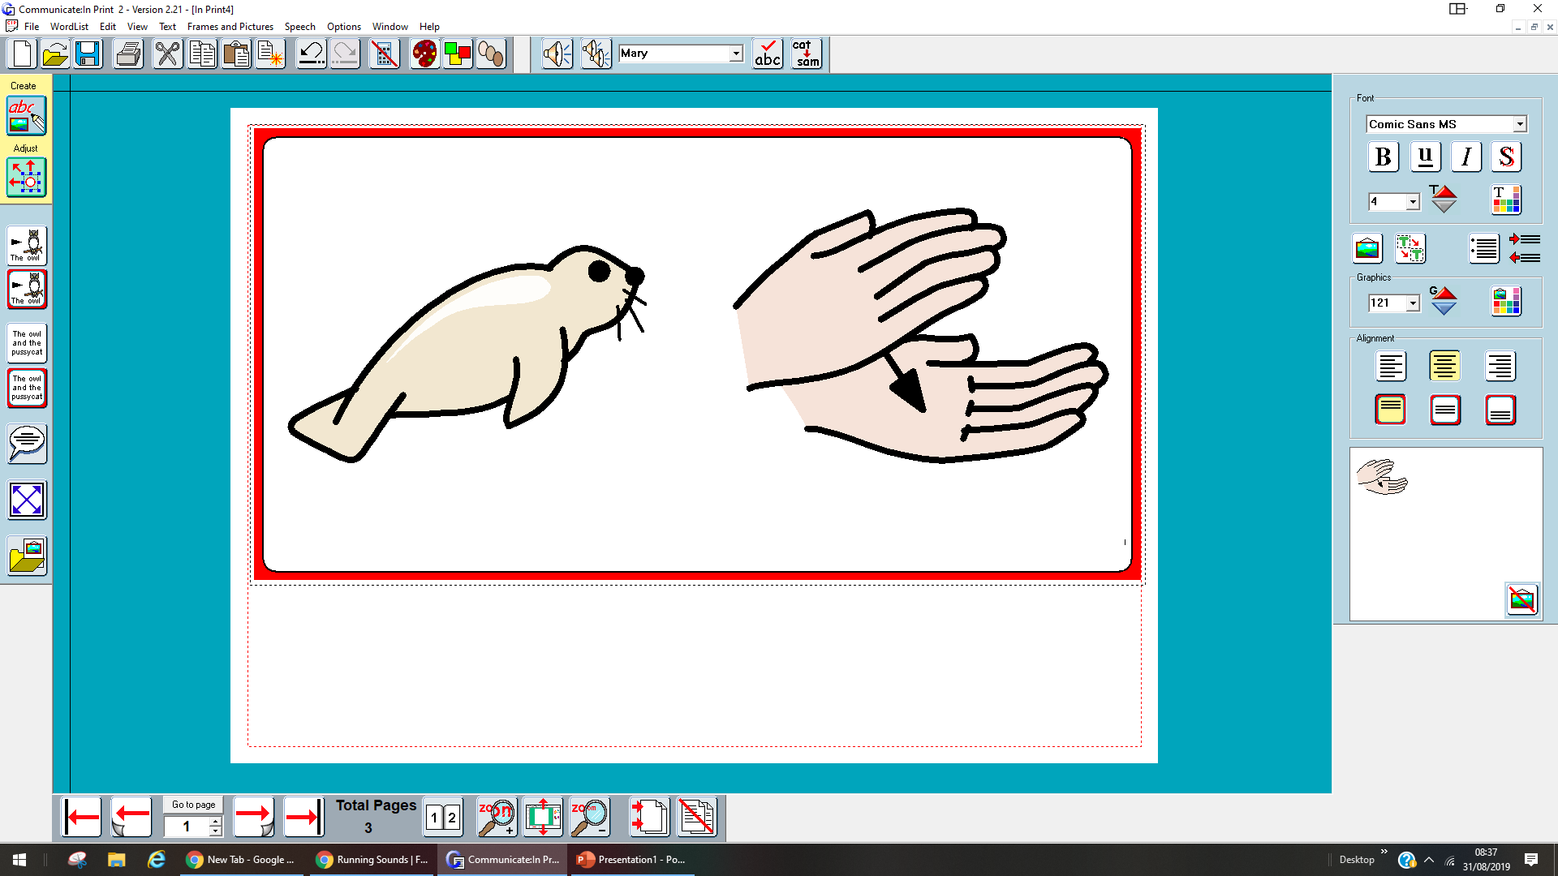
I want to be a seal clapping

Slide 11
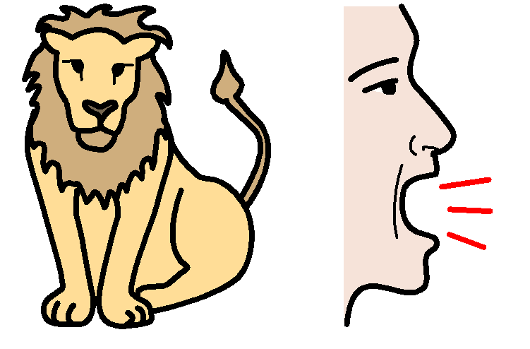
I want to be lion roar

Slide 12
NO
I want to be a goose
“Silly Suzy goose”

