Slide 1

Sound and Hearing
To recognise different sounds and where they come from.

Slide 2

Can you guess the sounds?

Slide 3
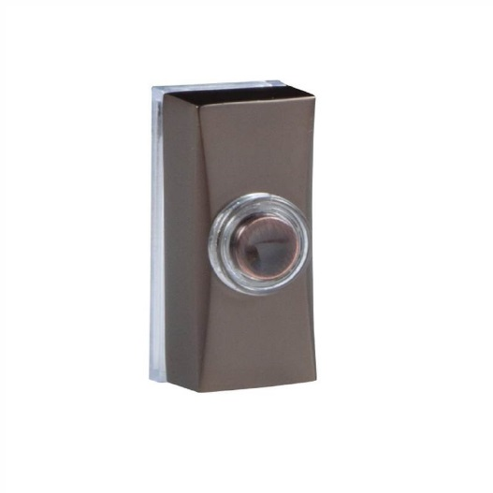

Slide 5


Slide 7
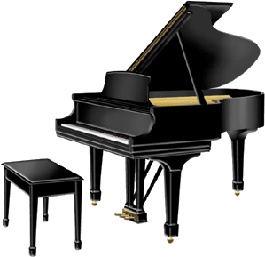

Slide 9
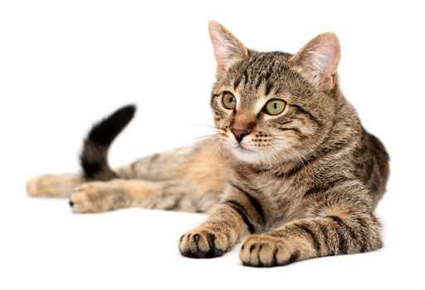

Slide 11
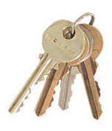

Slide 13


Slide 15
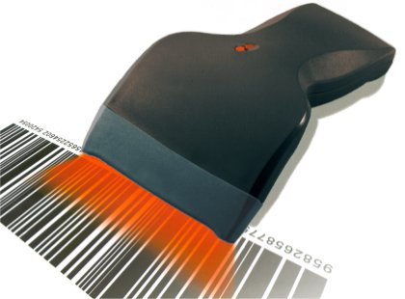

Slide 17
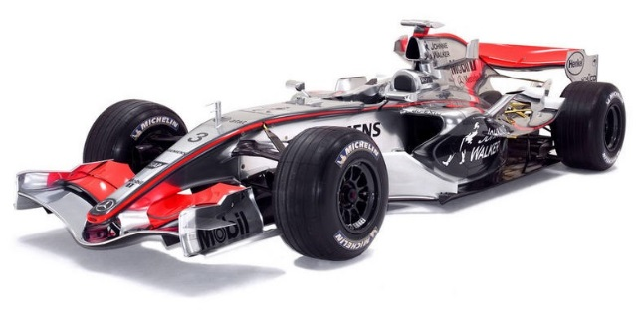

Slide 19
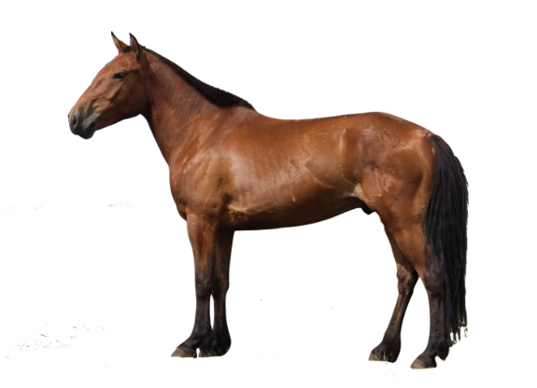

Slide 21
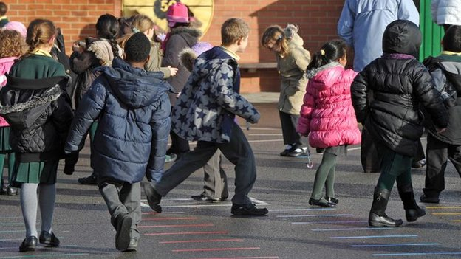

Slide 25
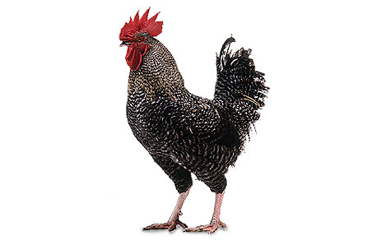

Slide 27
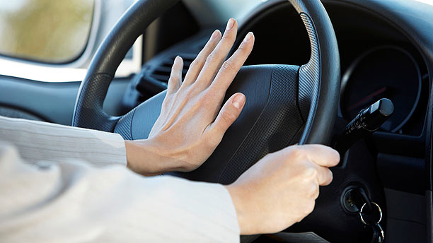

Slide 28
Can you guess
the sounds?

Slide 29
How many did
We guess right?

