Slide 1
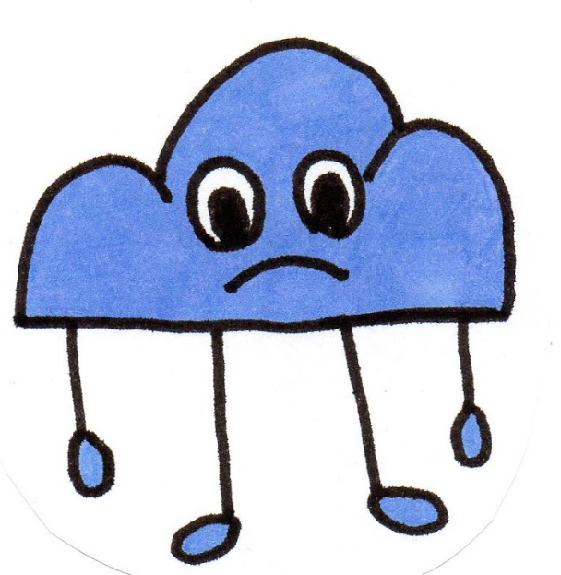
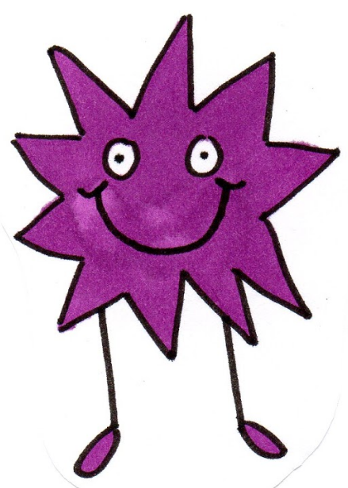
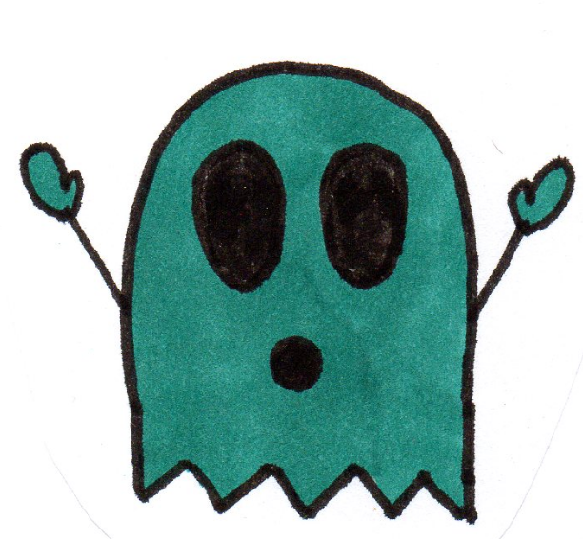
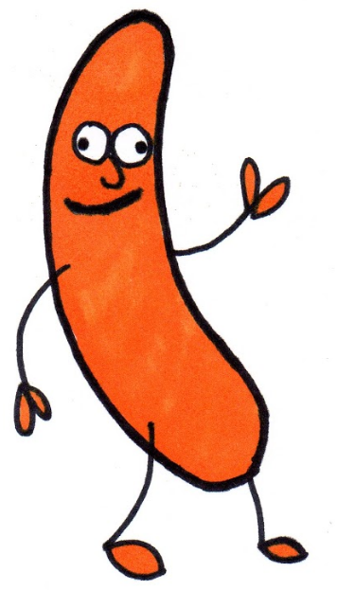
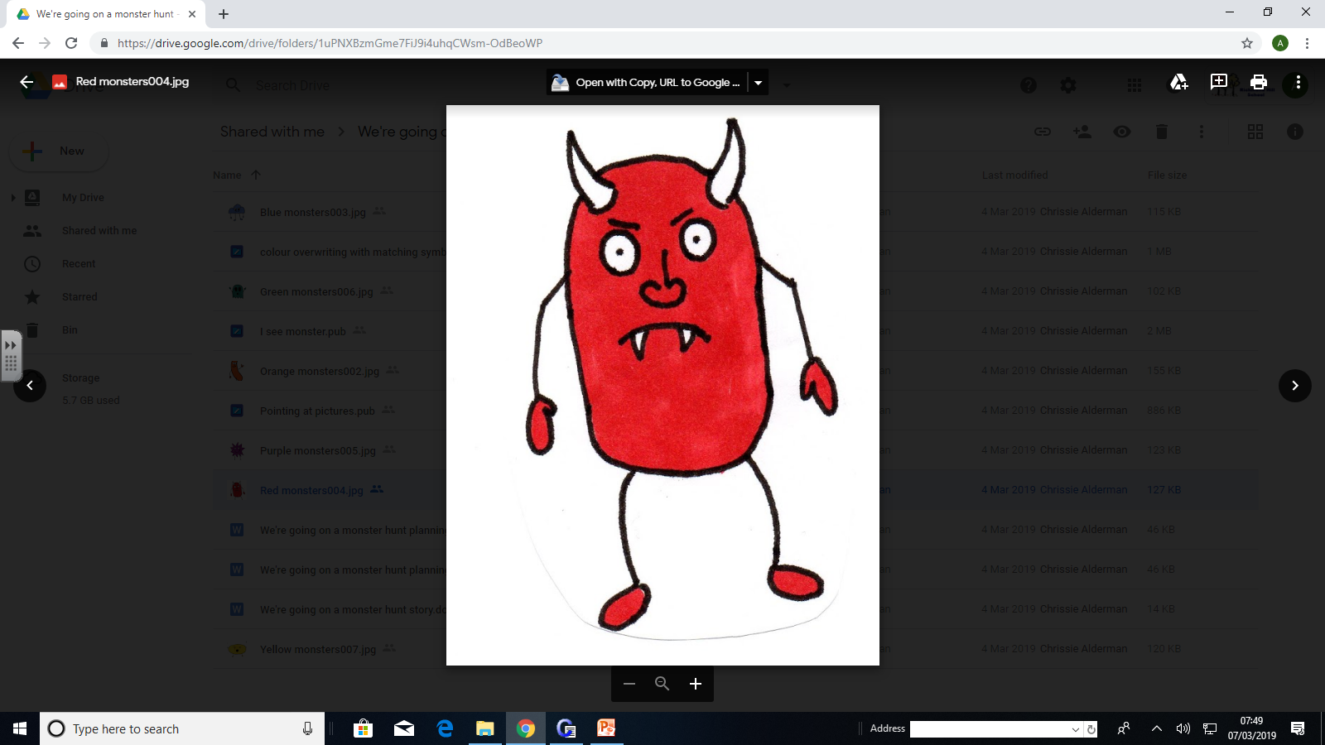
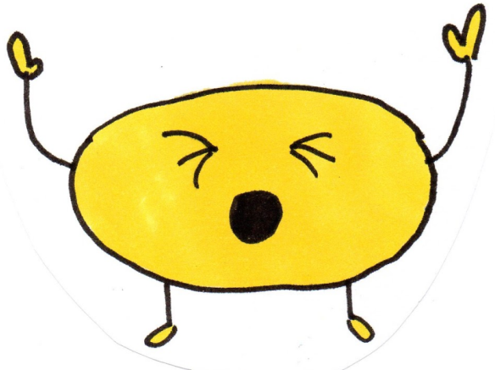
We’re going on a monster hunt

Slide 2
We’re going on a monster hunt
We’re going to find a red one
We’re not scared
What a colourful day
Uh oh! A lane, a dark, spooky lane!
We can’t jump over it!
We can’t crawl under it!
Oh no! We have to walk through it.
Tiptoe, tiptoe, tiptoe, tiptoe

Slide 3
We’re going on a monster hunt
We’re going to find a blue one
We’re not scared
What a colourful day
Uh oh! A supermarket: a loud, bright supermarket!
We can’t jump over it!
We can’t crawl under it!
Oh no! We have to walk through it.
Push the trolley, push the trolley, push the trolley!

Slide 4
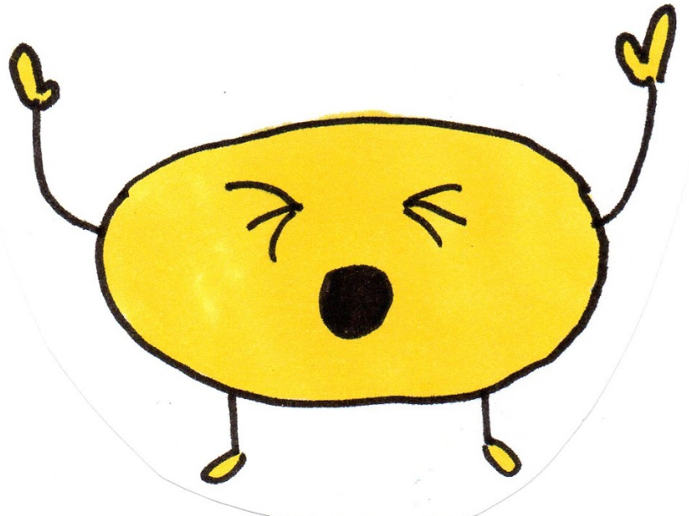
We’re going on a monster hunt
We’re going to find a yellow one
We’re not scared
What a colourful day
Uh oh! A road, a busy, noisy road!
We can’t jump over it
We can’t crawl under it
Oh no! we’ve got to safely cross it.
Hold Hands! Look, listen, look, listen, look, listen.

Slide 5
We’re going on a monster hunt
We’re going to find an orange one
We’re not scared
What a colourful day
Uh oh! A park, a big open park
We can’t jump over it!
We can’t crawl under it!
Oh no! We have to run through it.
Quick, run, run, run, run.

Slide 6
We’re going on a monster hunt
We’re going to find a purple one
We’re not scared
What a colourful day
Uh oh! An airport, with lots of huge aeroplanes
We can’t jump over it!
We can’t crawl under it!
Oh no! We have to wait and watch them.
WOW! Stretch and point, stretch and point!

Slide 7
We’re going on a monster hunt
We’re going to find a green one
We’re not scared
What a colourful day
Uh oh! What are these?
12 round googly eyes!
6 wet noses
Strange colourful fur
Ahhhh, it’s the colour monsters!
Quick get out the picnic, lets all have lunch!

