Slide 1
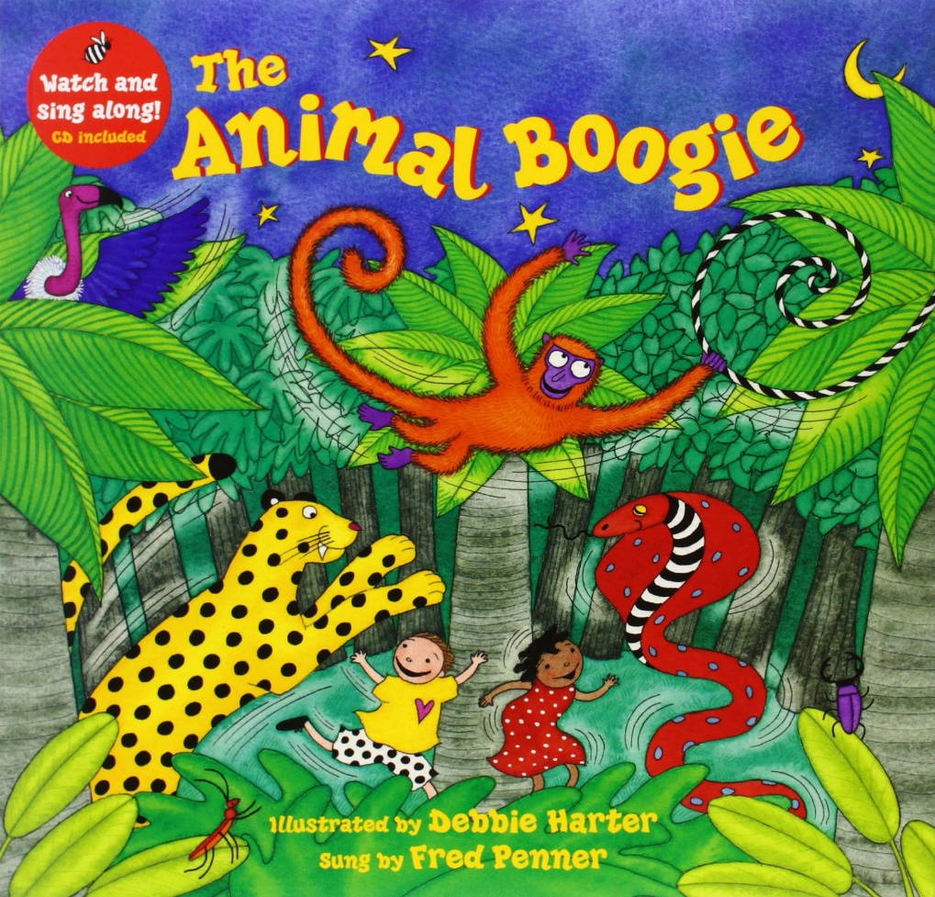
Animal Boogie
Write Dance
https://www.youtube.com/watch?v=25_u1GzruQM

Slide 2
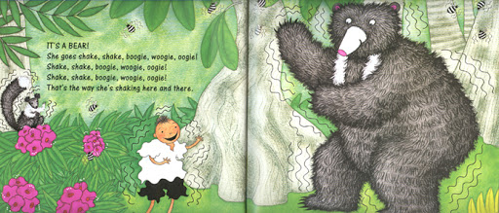
Shake like a bear…
Make your material shake.

Slide 3
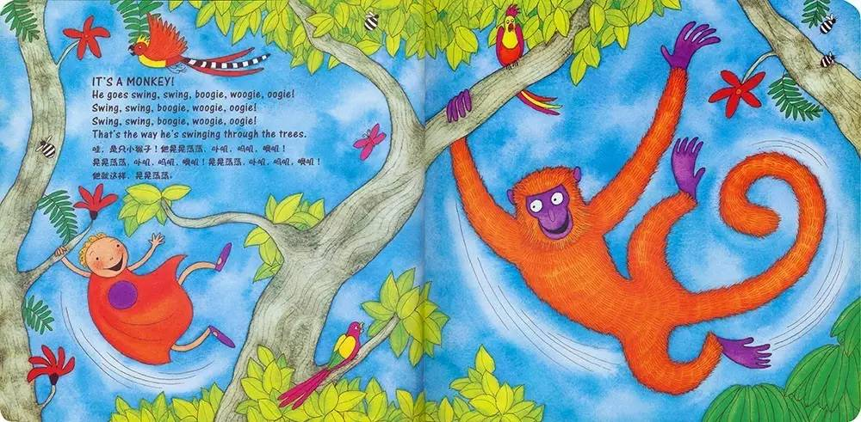
Swing like a monkey…
Swing your material from side to side.

Slide 4
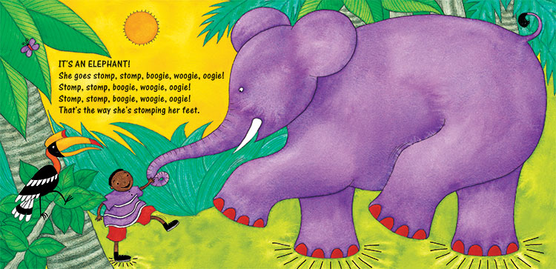
Stomp like an elephant…
Up and down with your material and stomp your feet.

Slide 5
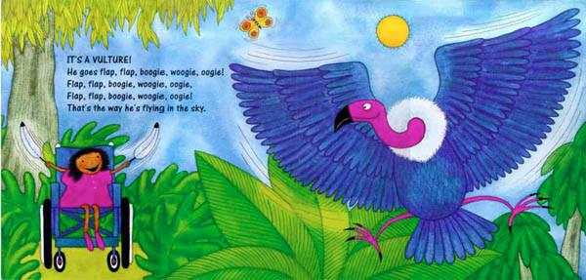
Flap like a bird…
Wave your material in the air.

Slide 6
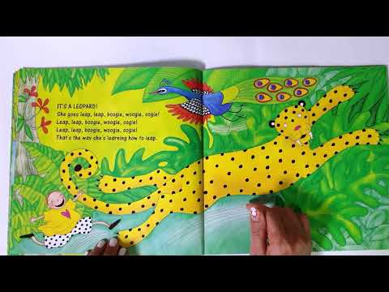
Leap like a leopard…
Move the material up and over.

Slide 7
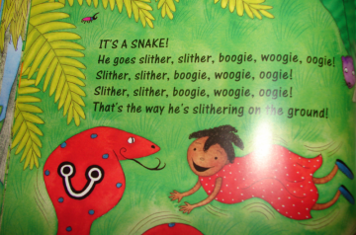
Slither like a snake…
Zig zag your material on the ground.

Slide 8
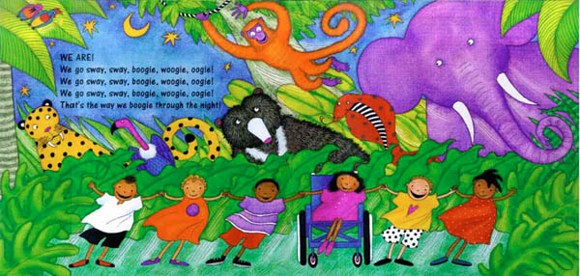
Dance like a human…
Dance with the material.

