Slide 1
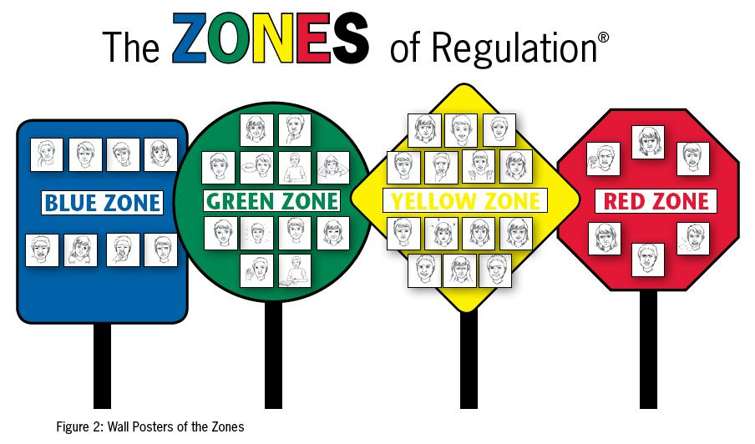
Zones of Regulation
Parent workshop November 2021

Slide 2
What is Zones of Regulation?
The Zones of Regulation is a cognitive behaviour approach for helping students self-regulate their behaviours, emotions, and sensory needs. By using concepts and visuals to help students learn to recognise their feelings and level of arousal, it allows them to employ strategies for optimal learning.
The Zones can be compared to traffic signs. When given a green light or in the Green Zone, one is “good to go”. A yellow sign means be aware or take caution, which applies to the Yellow Zone. A red light or stop sign means stop, and when one is the Red Zone, this often is the case. The Blue Zone can be compared to the rest area signs where one goes to rest or re-energize. All of the zones are expected at one time or another, but the curriculum focuses on teaching students how to manage their Zone based on the environment and people around them. For example, when playing on the playground or in an active/competitive game, no one would think twice about one being in the Yellow Zone but that would not be same in the library. – Zones of Regulation
Although the Zones of Regulation is often used to support the needs of children with ASD or ADHD, it is very much applicable to all children, and even adults. The ability to recognise our own state of arousal and to make the necessary adjustment so that it is appropriate for the occasion we face is something we all require to function optimally.

Slide 3
The Goals of the Zones of Regulation
The goals of the zones of regulation are to teach children to:
identify their feelings and levels of alertness
develop effective regulation tools
learn when and how to use the tools
problem solve positive solutions
understand how their behaviours influence thoughts and feelings
ultimately – develop independent regulation
The Four Zones of Regulation
Blue Zone: low level of arousal; not ready to learn; feels sad, sick, tired, bored, moving slowly.
Green Zone: calm state of alertness; optimal level to learn; feels happy, calm, feeling okay, focused.
Yellow Zone: heightened state of alertness; elevated emotions; has some control; feels frustrated, worried, silly/wiggly, excited, loss of some control.
Red Zone: heightened state of alertness and intense emotions; not an optimal level for learning; out of control; feels mad/angry, terrified, yelling/hitting, elated, out of control.

Slide 4
‘Self–regulation is the ability to manage disruptive emotions and impulses, and to think before you react.’ – Mind Tools

Slide 5
What happens when children cannot self-regulate?
Children that are unable to self-regulate are prone to the following:
tantrums and outbursts
abusive behaviours – e.g. self abuse, punching, kicking, biting
emotional distress
inattention/distractibility
refusal to participate

Slide 6
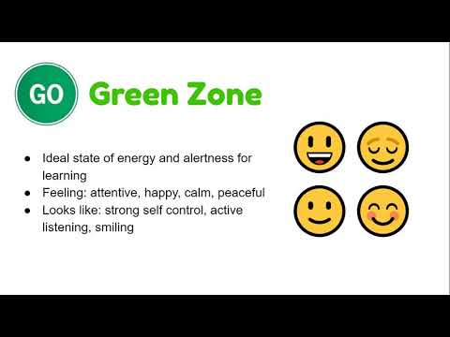

Slide 7
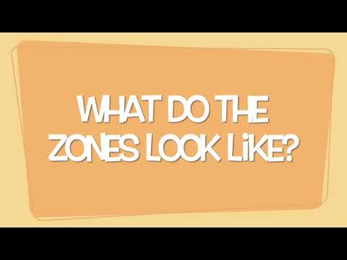

Slide 8
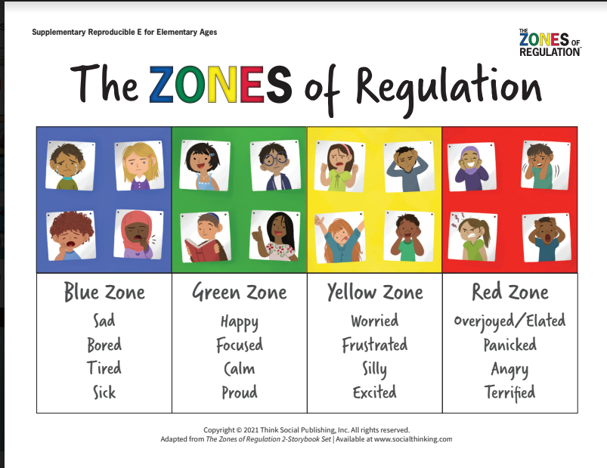

Slide 9
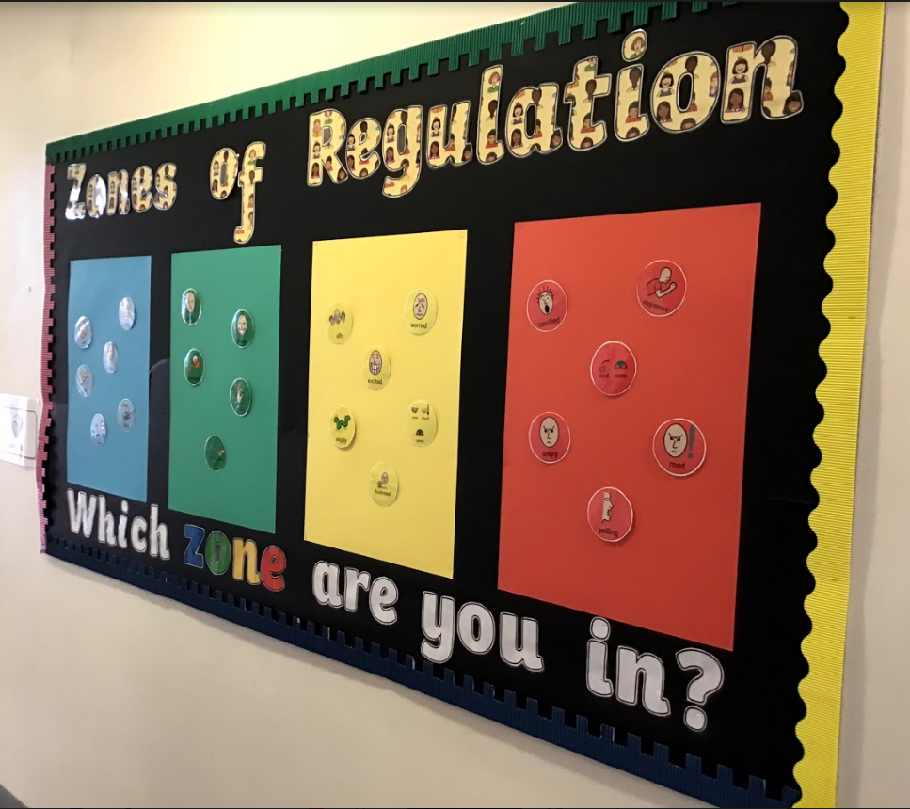

Slide 10
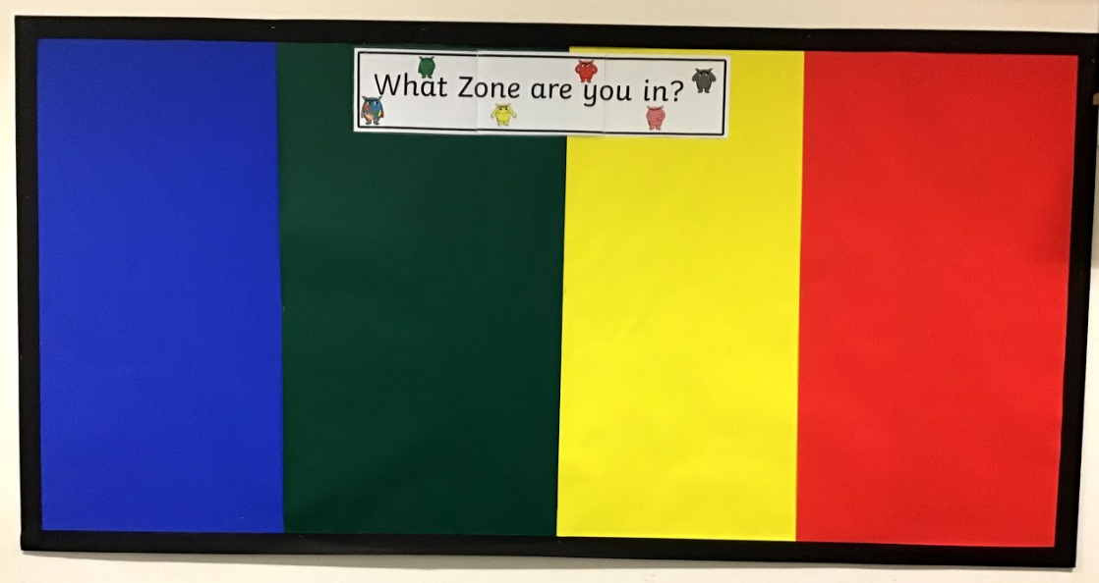

Slide 11
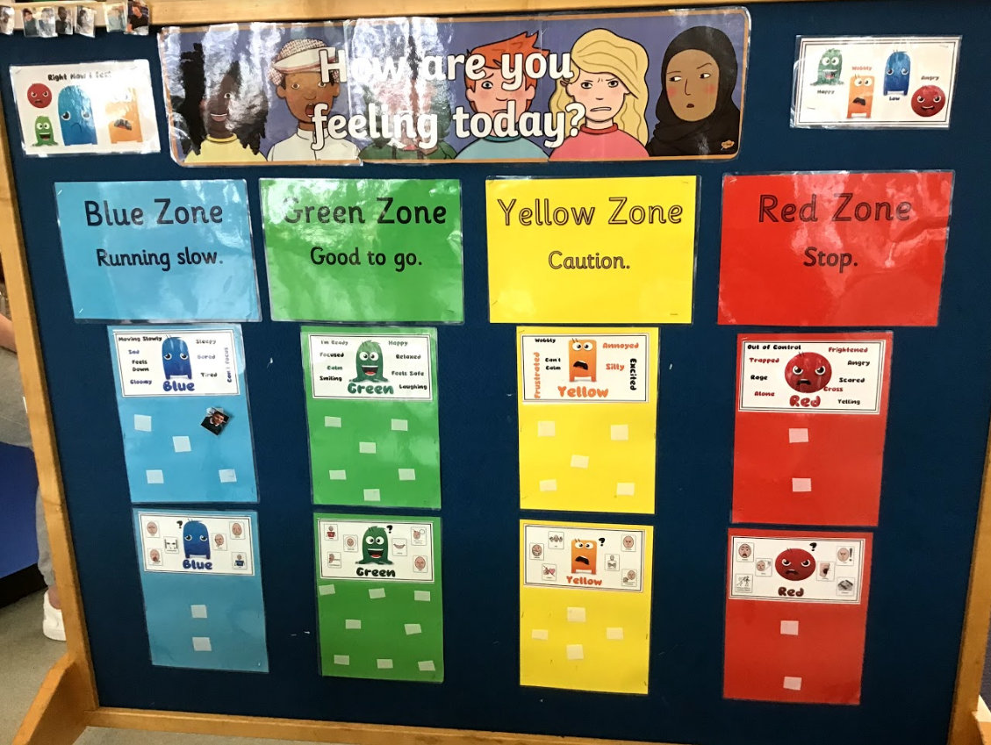

Slide 12
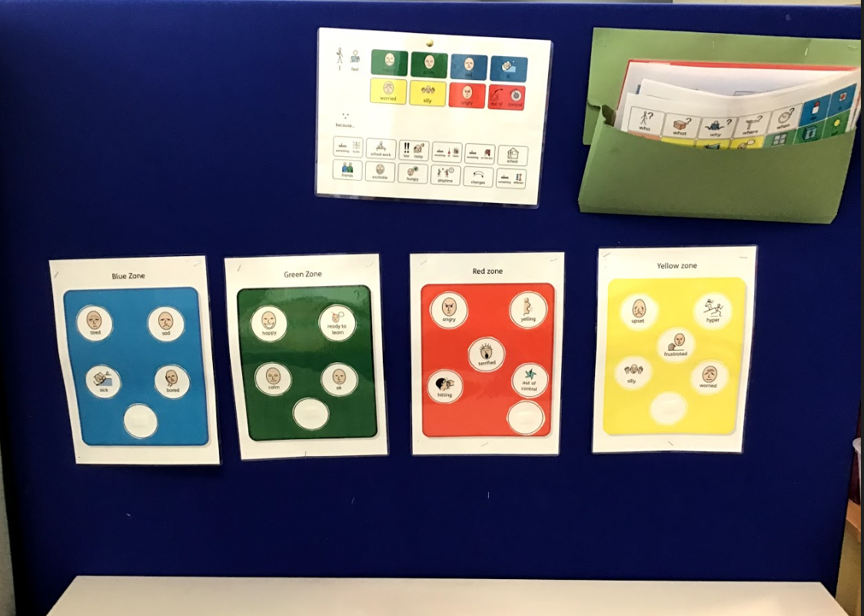

Slide 13
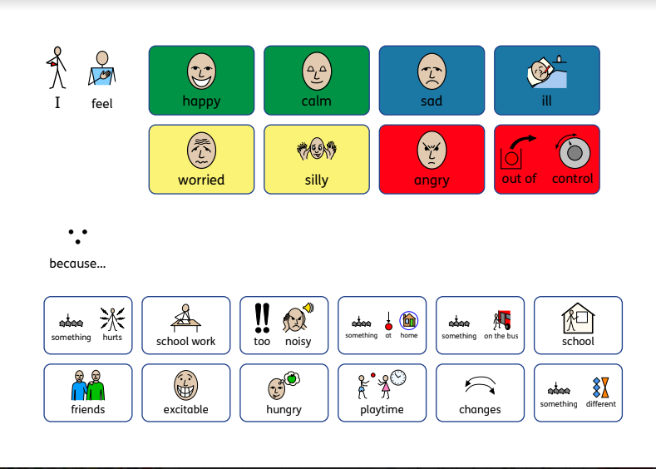

Slide 14
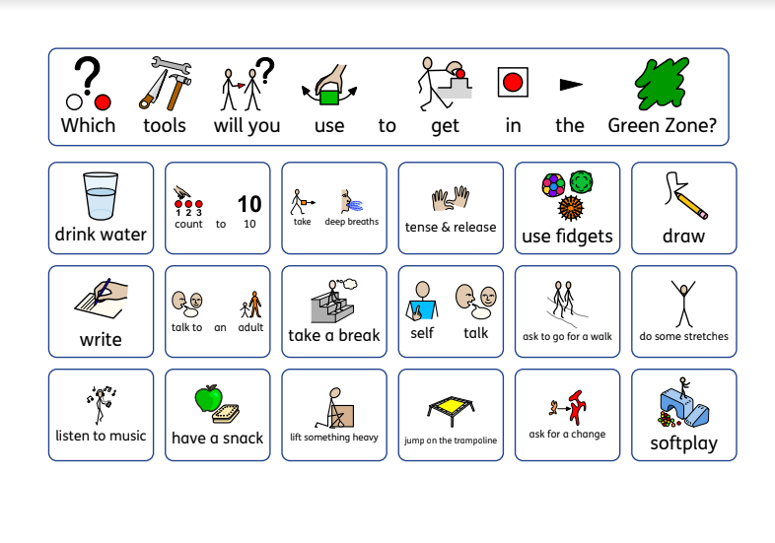

Slide 15
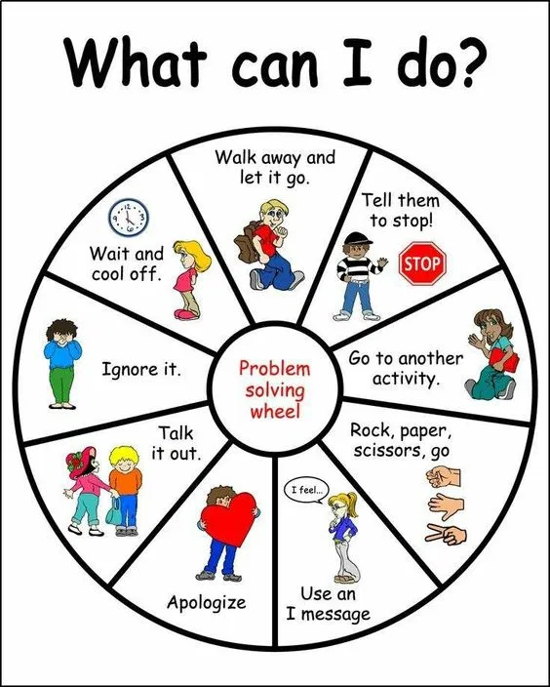

Slide 16
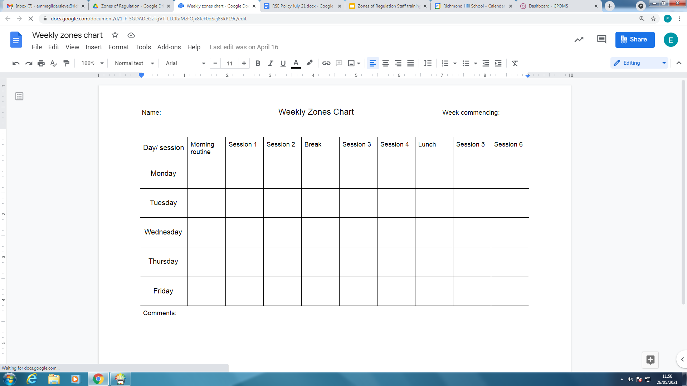
Rainbow Class

Slide 17


