Slide 1

Behaviour and
De-escalation

Slide 2
Aims for the session:
To develop your understanding of behaviour
To develop skills for working with behaviours at home.
To develop positive verbal and non verbal communication, diversion and de-escalation skills.
To provide next steps in supporting behaviours at home

Slide 3

Holistic approach at RHS
We seek to support all children by:
understanding what drives their behaviour
developing skills and approaches to enable us to provide them with the help they need
Best interests of the child
Behaviour Management strategies
Positive behaviour support approaches emphasising
de-escalation
Safeguarding

Slide 4
Everyday strategies
Tactical ignoring: (a decisive choice not to notice). This may be used occasionally for low level disruptions. If you ignore behaviour, ensure there are sound reasons for doing so.
Reinforce appropriate behaviours: When a child does positive behaviours that you want – reinforce & praise it.
Non-verbal gestures: may often be sufficient.
Distractions & diversions or the use of humour often helps.

Slide 5
Stress factors often result in challenging behaviour
family-related problems
Misunderstandings
Change of adults
Strong emotions in others
Sudden noises
Inability to make others understand
Poor communication
Growing up
Sudden changes
Lack of structure
A breakdown in communication
Change of routine
Not finishing something
Dislike of particular people
Being told off
Injustice or unfairness
December
Great life events
Making mistakes
Sleep problems
losing
parties
Aches and pains
Other children
Demands
Toilet problems
Different foods
Notes:
The stress factors – what we can’t see under the surface
Misunderstandings, together with Poor communication and a breakdown in communication lead to challenging behaviour

Slide 6
Understand what function the challenging behaviour serves
To gain attention
To gain a tangible consequence: e.g. a treat, a favourite toy or video.
To gain a sensory consequence: e.g. to get warmer if one is cold
To self-regulate one's emotions: to calm down if agitated
To escape from or avoid an undesirable situation.
To make a comment or declaration about one's environment, perceptions, or emotions.
To fill a habitual need

Slide 7
We should aim to:
Support children to learn and use more socially acceptable ways of expressing their feelings…

Slide 8
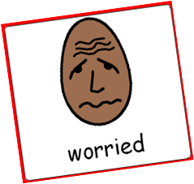

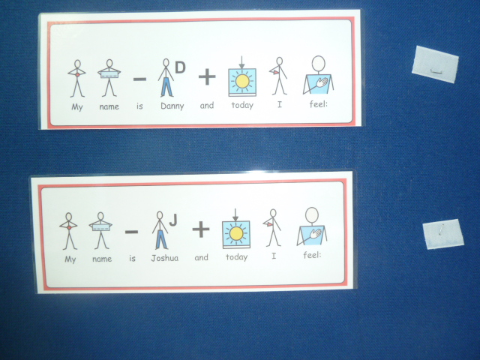
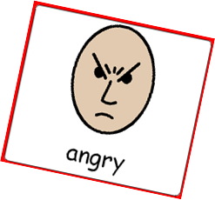
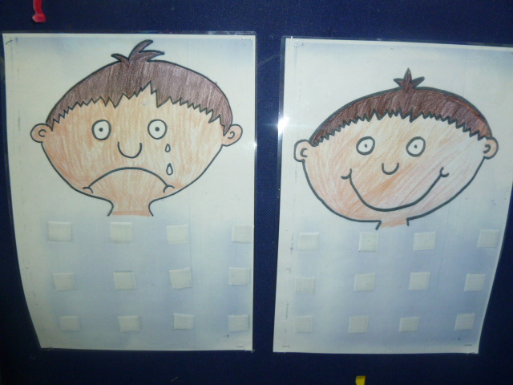
Teaching facial expressions and emotions
Notes:
Need to teach emotions as young person is feeling them. ‘Kamal, you are frustrated because the minibus is not working and we cannot go swimming’. ‘James is angry because the computer is broken’

Slide 9
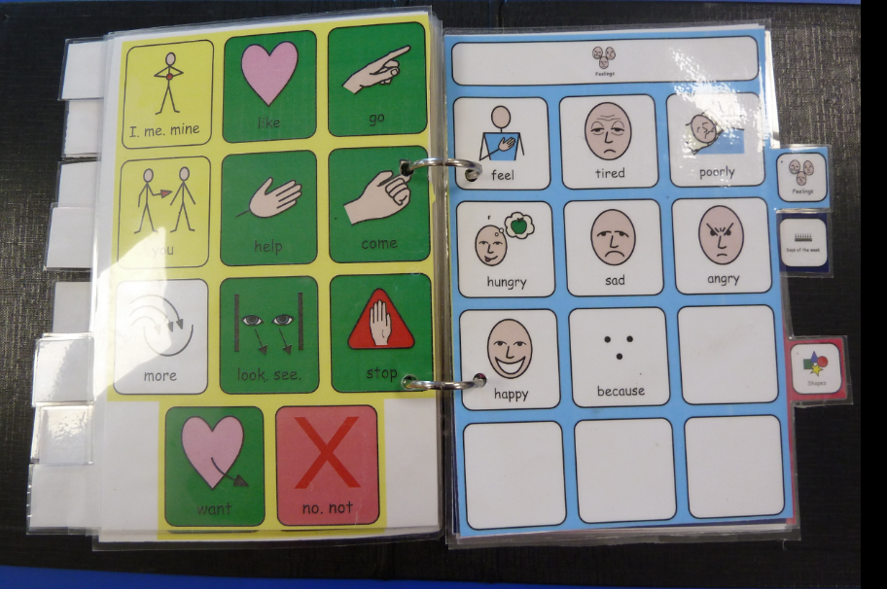
Feelings page in communication book

Slide 10
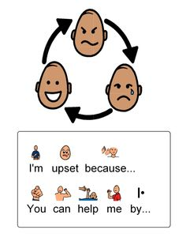
You can help me…
take a walk with me
give me space
reduce noise level
give me choices
time to think
talk less

Slide 11
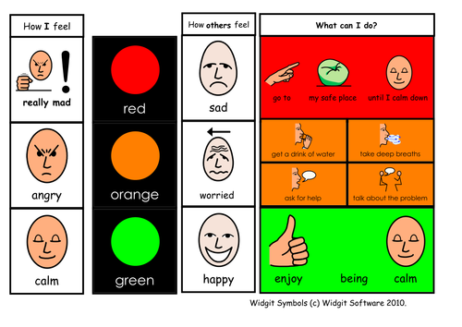
Teaching understanding & expression of emotions
Notes:
Modelling emotions
Emotion pictures
Emotion keyrings
Feelings book
When I’m stressed I can…
You can help me by…take a walk with me, give me space, reduce noise level, time to think, talk less, give me a treat

Slide 12
How can we help. In a tense situation…try to remain Calm…
Communicate
  body language
  intonation
  scripts
  reading behaviour
  anticipating what might happen next
  knowledge of behaviour
  plan strategies
Awareness & Assessment
Listen and Look
  give time and space
  allow pauses for take up time
  give them a way out
Make Safe
  environment
  personal

Slide 13
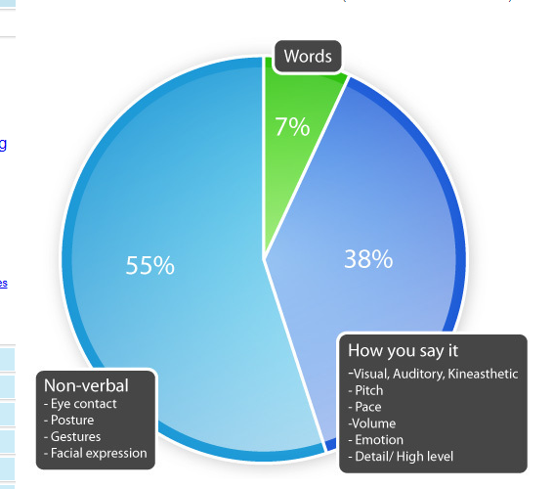
Albert Mehrabian ‘s Communication model
We communicate globally with one another by means of language, gestures, signs and pictures.
It is almost impossible not to communicate.
Professor of psychology Albert Mehrabian studied the importance of non-verbal communication in the 1970s.
7% of what we communicate consists of the actual words
38% - how you say it
55% - body language

Slide 14

Self Management Checklist
Body
Square on
Inflate
Waving arms
Face
Pulling faces
Wide eyes
Rolling eyes
Voice
Too much talk
Shouting
Jabbering
Body
Drop sideways
Shrink
Press elbows into sides
Face
Blank expression
Smiling eyes
Voice
Try no talking
Lower the tone
Lower the volume
Lower the pace
Ask yourself
Am I the right person to be dealing with this situation?

Slide 15
Some typical signs of anxiety are:
Facial muscles tensing or twitching
Breathing becomes shallow and short
Changes in voice tone
Changes in facial colour
Wide eyes
Agitated behaviour e.g. pacing
Repeated phrases
Rigid body with crossed arms
Clenched fists
A jutting jaw
Chest stuck out
Unfocused abuse – often precedes a physical attack
Notes:
Not an exhaustive list

Slide 16
6 Stages of a Crisis
Primary
Secondary
Tertiary
…within holistic positive behavioural support approach
Crisis
Support required specific to each individual child.
Recovery
Defensive/ Escalation
Need for coordinated letting go. Support, reassurance
Depression
Anxiety / Trigger
Need for diversion, reassurance, clear limits, boundaries and choices
Need for observation, support and monitoring - recovery and repair
Restoration
Need for diversion, support and reassurance
Reflect
Repair
Reconnect
Stage 1
Stage 2
Stage 3
Stage 4
Stage 5
Stage 6

Slide 17
Stage 1 – Anxiety/trigger
Low level behaviours
Low level responses
Signs of anxiety
Hands over ears
Hides face in hands
Rocks or taps
Withdraws from group
Refuses to cooperate
Refuses to communicate
Adopts defensive posture
Read behaviour
Read body language
Intervene early to remove sources of frustration
Offer reassurance
Explain now/next
Use appropriate humour
CALM body language
Talk – low, slowly, quietly
Assess the situation
Divert/distract
“Talk and I’ll listen”
Notes:
List is not exhaustive

Slide 18
Stage 2 Defensive
Medium Level Behaviours
Medium Level Responses
Higher tension displayed
More movement
More noise/s made
Pacing
Aggressive postures
Low level destruction
Picks up objects which could be used as weapons
Continue level 1 responses
State desired behaviours
Use distraction to refocus attention positively
Set clear boundaries
Offer alternatives/options
Offer clear choices
Give a ‘get out’
Assess the situation – consider making environment safer, getting help
Remove audience

Slide 19
Language - Getting it right
Say child’s name first to get attention
Avoid ‘no’
Reduce the language used to focus on the meaningful elements. Stress key words.
Give one instruction at a time
Target praise to activity – good sitting, listening etc.
Request by saying, ‘David, show me good sitting please’
Tell the child what to do, not what not to do.
Notes:
Don’t say ‘No’, do say ‘stop’, ‘wait’, ‘look’, ‘listen’ etc
Don’t say, ‘It’s dinner time David, come and sit down now, turn off that video, quick it’s getting cold’.
Do say, ‘David, dinner’
‘David, still feet’ not ‘Don’t keep stamping your feet’.
Use consistent language- jumper, pullover, sweater, jersey?

Slide 20
Visual Schedules
Provide visual cues that tell children what activities will occur during the day and in what sequence.
We can adapt to child’s level of understanding and individual needs)
Help children with language difficulties understand what is expected of them.
Lessen anxiety
Can help to increase flexibility when a change is unavoidable
Help children make transitions between activities in their independently- ‘this is where I go next’.
Notes:
In times of stress- communication can be limited – so keep it simple
Can help to avoid conflict – ‘the schedule says….’
Can incorporate a red cross or ? For a change or surprise

Slide 21
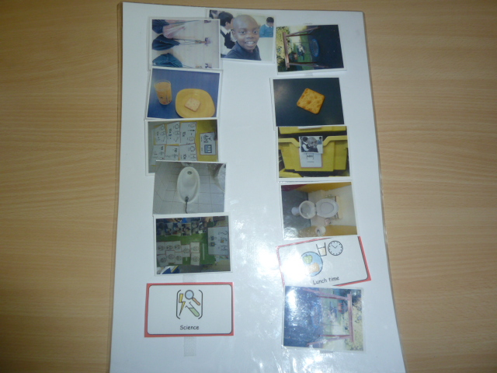
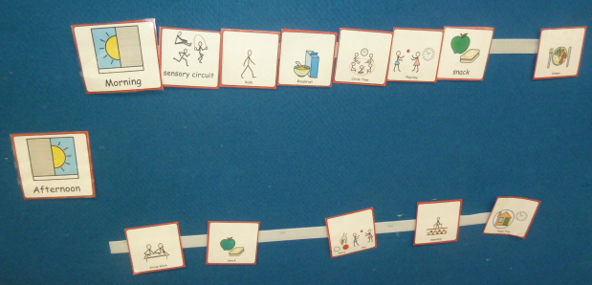
Photos & symbols

Slide 22
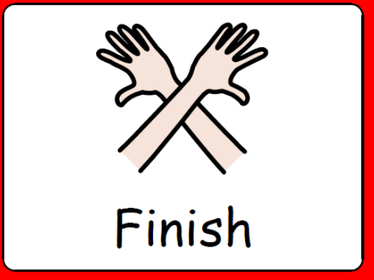
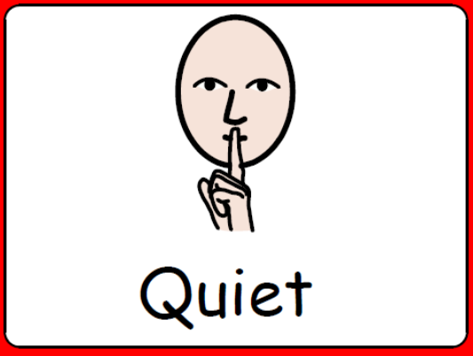
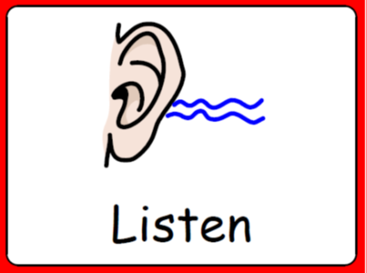

Portable timetables
Notes:
Strips and key rings

Slide 23
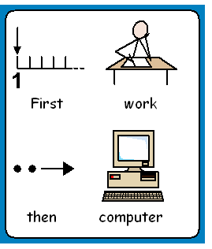
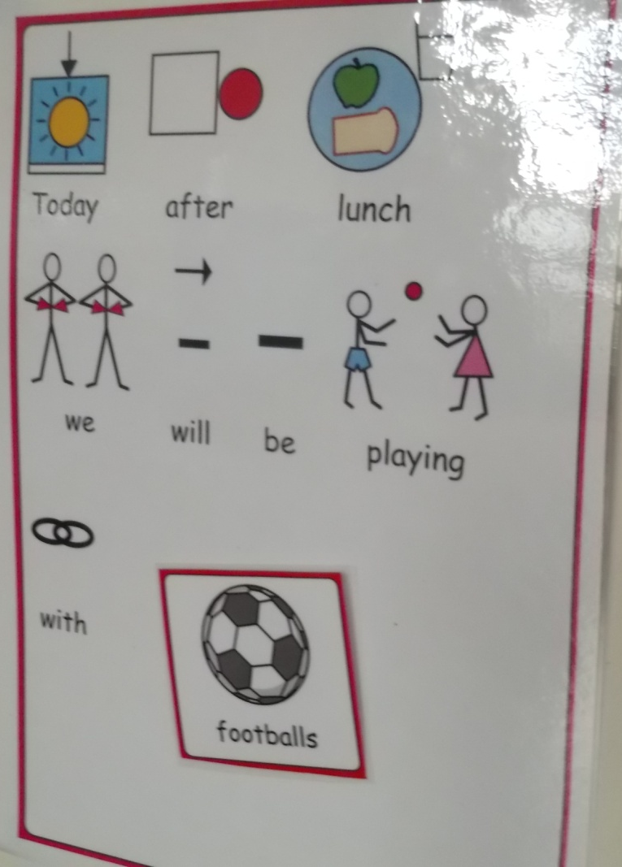
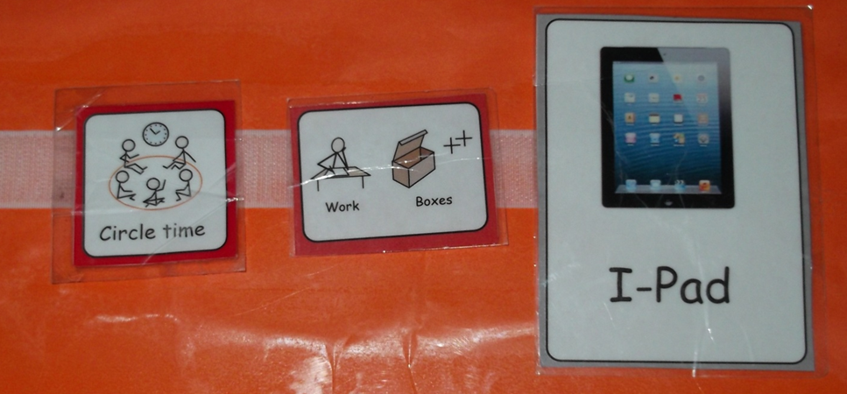
What’s next?

Slide 24


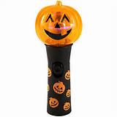
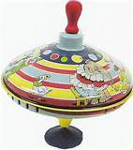
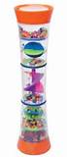
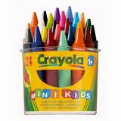
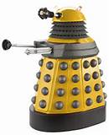


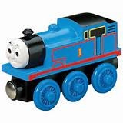
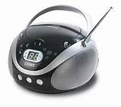
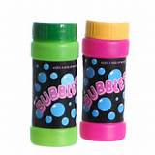

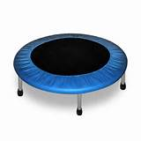

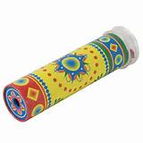
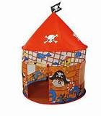
Motivation
I am working for…
Notes:
I’m working for…
Child’s reinforcers and motivators may not be huge or be motivating for us. Try a range of different things. Develop sensory boxes. Use reinforcer checklist.

Slide 25
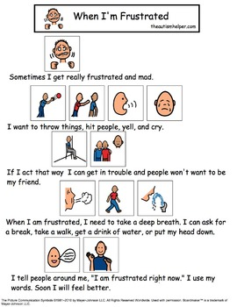
Social stories
Can be used to support emotions, explain changes, support self regulation and much more.
It offers the child options and possible solutions.
It provides reassurance (non verbal).

