Slide 1

Behaviour Training
SDP- Behaviours and Attitudes

Slide 2

Objectives and aims
What is Team Teach?
How we support and manage behaviour through Team Teach strategies.
Terminology explained
Introduction to our current documentation- BSPs & Risk Assessments
Communication with parents.
Outline key features of our behaviour policies.

Slide 3
Team Teach

Slide 4
What is Team Teach?
"Team Teach" is the holistic approach we use to support people who may exhibit more challenging behaviours.
The approach is based on a risk reduction approach, involving de-escalation strategies, diversion and as a last resort physical intervention. Sometimes some of our learners may get anxious or agitated – we support them to achieve calm using communication skills, distraction techniques and by removing identified triggers where possible.
The positive behaviour management strategies that Team Teach develops and promotes emphasise team building, personal safety, communication, and verbal and non-verbal de-escalation techniques for dealing with challenging behaviour which reduce the need for physical intervention. As a last resort, it also teaches positive handling techniques to resolve conflicts in ways that are safe, and which provide opportunities for repair and reflection for everyone involved.

Slide 5
Team Teach thinking
Positive environments empowering children to safeguard themselves
We need to help children and young people to regulate their own behaviour and develop self control
Empowering adults to safeguard children
We cannot have a ‘zero tolerance’ approach towards restraint. Restraint is permissible when it is in the best interest of the child
Dynamic Risk Assessment
We want staff to be confident enough to think about which of the available options have a reasonable chance of working - balance risks, including the risk of not taking action
Best interest principal is paramount
Which of those options is likely to have the best outcome for the child?
What would you want someone else to do if it was your child?

Slide 6
Reasonable. Proportionate and Necessary
The legal system of the United Kingdom and many commonwealth countries share a concept of common law. It hangs on the word ‘reasonable’. Yet the word keeps changing meaning depending on the circumstances of each case. For example an action taken in response to an attack with a baseball bat might be deemed reasonable by a court, whereas exactly the same action taken in response to a verbal assault would be judged excessive and unreasonable.
What determines reasonableness of a particular intervention is whether or not it is was ‘proportionate’ to the circumstances it was intended to prevent. What would have happened if you had done something else or not done anything at all? Would that have been worse?

Slide 7
Working realities
Team Teach advocates that services should include in their policy a statement that reflects the working realities and likely consequences when individuals are involved in an incident involving use of force.
The following statement should be made both in local & corporate policy:
“Team Teach techniques seek to avoid injury to the service user, but it is possible that bruising or scratching may occur accidentally, and these are not to be seen necessarily as a failure of professional technique, but a regrettable and infrequent “side-effect” of ensuring that the service user remains safe”.
George Matthews - Founder

Slide 8
Why Team Teach?
•Seeing beyond “restraint” and understanding the benefits to be gained by empowering all staff to share in the knowledge of what is, and is not, reasonable use of force.
•Improved teamwork and communications skills.
•A stronger sense of professional security around anxious, troubled, and sometimes troublesome individuals.
•Providing a layer of “safety” for the employer, workers, those the service supports.
•Encouraging management to act responsibly, by equipping and supporting staff with a sufficient range of tools to enable them to respond and reduce foreseeable risk.

Slide 9
At RHS:
We have two onsite Team Teach trainers
100% of our staff receive Behaviour training and de-escalation training.
Since introducing Team Teach techniques data shows a reduction in restrictive physical interventions.
Staff who are not Team Teach trained will act in loco parentis.
Team Teach and Behaviour forms part of our SDP.

Slide 10
Supporting behaviours
Communication
- stance - posture - gesture - facial expression
- intonation - scripts
Awareness and Assessment
- reading behaviour - anticipating what might happen next
- knowledge of handling plans
Listening and learning
- give time and space - allow pauses for take up time
- give them a way out
Making Safe
- objects - space - hotspots - safety responses

Slide 11
RHS 7 key statements for supporting behaviour
At Richmond Hill School we have developed 7 key statements for supporting and developing appropriate behaviour in our children.
We will always try to understand you and your needs.
We will always try to use a positive and proactive approach to managing behaviour.
We will always try to be reflective and flexible in our attitude, recognise our own limitations and accept that we might need to change our approach.
We will always try to use tailored reward systems, positive praise and give appropriate consequences.
We will always handle you in a safe, controlled and positive manner.
We will always try to work as part of a team, offering you consistency and a fresh face when needed.
We will always try to look at each situation from your perspective.

Slide 12
Terminology

Slide 13
Supporting/ Contingent Touch
‘Contingent Touch’ is used to mean everyday acts of communication by physical means to indicate approval, affection or sympathy. Touching can be a positive reinforcement to relationships and a comfort in times of stress or distress. However we remind staff that they must always remain conscious of the physical context and appropriateness of their actions.
Examples of times when we use this at Richmond Hill could be - modelling appropriate methods and techniques in a range of practical subjects e.g. Art, DT, supporting in Physical Education activities by providing appropriate physical prompts, holding hands when walking around the school, next to the road or out on a trip.

Slide 14
Positive Handling
Holding may be used appropriately; by this we mean providing physical direction similar to contingent touch but more directive in nature e.g. the learner is guided away by the hand/arm/around the shoulder or for the very young pupils it may mean more physical support – cradling or hugging (using Team Teach practices).

Slide 15
Restrictive Physical Intervention
Restraint is the positive application of sufficient force to ensure, by physical means alone, that a learner does not cause injury either to him/herself, a member of staff, another child or young person, or significant property damage.
Restraint should only be used as a last resort once all other options have been exhausted.
Any form of restraint should be used only when Reasonable, Proportionate and Absolutely Necessary.
Should only be used if the learner is putting himself/herself or others in danger and damaging the environment and where failure to intervene would constitute neglect.
All incidents involving restrictive physical intervention are recorded, on the same day, onto CPOMS. All incidents of physical restraint are then recorded in a numbered and bound book by a Team Teach Lead/Senior Management and reported to parents.

Slide 16
Unforeseen or Emergency situations
On occasion, staff may find themselves in unforeseen or emergency situations when they have no option but to use reasonable force to manage a crisis. It is recommended that:
before handling a child - staff attempt to use diversion or de-fusion to manage the situation
if needed call for Team Teach trained staff in the event their support is required.
when using positive handling - staff must use Team Teach techniques and methods for which they have been trained.
in exceptional circumstances (where permitted techniques are ineffective or staff are unfamiliar with the action they should take) – staff manage the situation as best they can and act ‘in loco parentis’.
All unforeseen or emergency use of physical intervention, are entered onto CPOMs on the day it occurs and a team teach lead/assistant head is informed. Parents must be informed of this and may lead to a risk assessment being carried out on the pupil and Team Teach handling added to their Behaviour Support Plan.

Slide 17
Documentation

Slide 18
Working with parents
Good communication between home and school is fundamental in pupils making progress.
Our aim is to be transparent, we want to work with you to support your child in the best possible way.
You will be notified of incidents and depending on the severity of the incident this will be either be via a telephone call or the home school book.
When there is a new behaviour or escalating behaviours we will inform you and perhaps arrange with you to come into school for a behaviour support meeting.
Behaviour support plans must be agreed by parents and signed.

Slide 19
Behaviour Support Plans
By October half term all pupils requiring a behaviour plan will be transferred onto RHS’s new Behaviour Support Plan document.
As and when class teams will have the opportunity to have behaviour support meetings throughout the year.
BSP’s must be agreed by the class team and parents.
The new BSP’s look at the stages of crisis and the support that we put in place at each stage (to hopefully prevent crisis).

Slide 20
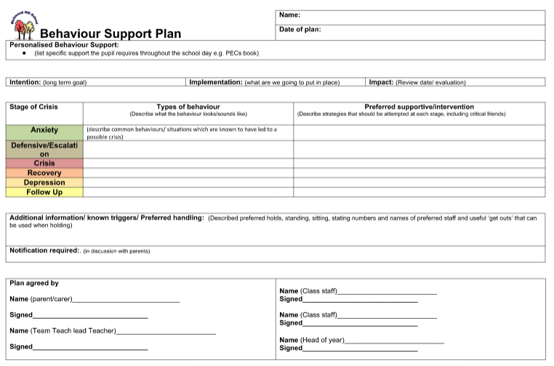

Slide 21
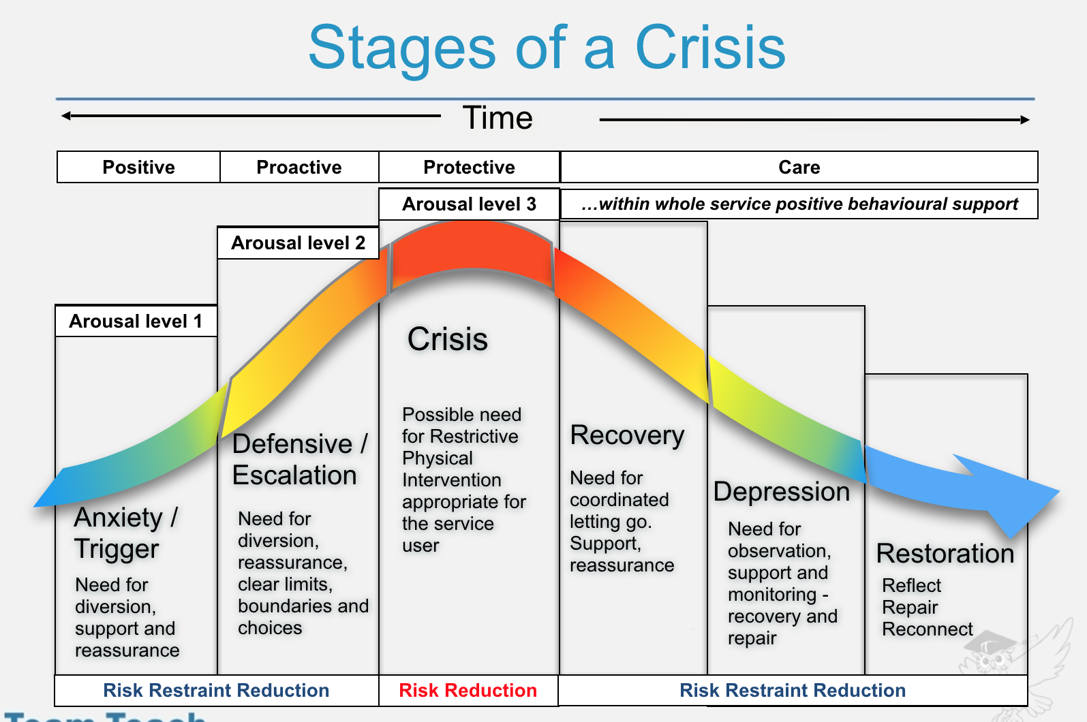

Slide 22
Risk assessments
Some pupils behaviour will require a Risk Assessment to be carried out by the AH and class teacher (this will inform BSP).
The risk assessment will ensure the correct support and interventions are in place to reduce the risk, reduce the use of Physical Restraint and hopefully prevent the incident occurring again.
Risk assessments will be shared with parents and be agreed.
If staff feel they are unable to work with a child / children, for example; someone with a broken arm would be unable to work with a child that has physical restraint on their behaviour plan then they can complete a Risk Reduction form. This is to safeguard both the child and staff.
These Risk Assessments will also inform ESRAs for trips.

Slide 23
Policies

Slide 24
Positive Behaviour Policy
At RHS we believe that:
Behaviour is a means of communication – we must ensure that all learners are supported to communicate their needs safely and appropriately using their preferred communication system.
With the right support and intervention, learners can learn to self-regulate and manage their own behaviour.
Mistakes are part of the learning process and we recognise that all our learners are at different stages of the development process.
All of our learners have learning difficulties and other complex needs which can impact on how they learn to regulate and manage behaviour.
Teachers and class teams must be given the opportunity to learn, understand and have insight into why our learners become dysregulated and reflect on how/why it impacts on their behaviour.
To work collectively with our learners, parents/carers and other professionals to develop strategies as part of a positive behaviour support plan to support them to self-regulate and manage their behaviour in a positive manner.

Slide 25
Positive Handling Policy
Class staff will attend regular Team Teach training and it is an expectation that any physical intervention will be in accordance with this training.
Staff may use physical intervention only if they have attended the relevant training and been signed off by the Lead Trainer for the training session they attended.
However, as Section 93 of the Education and Inspections Act 2006 states that all members of staff have a legal power to use “reasonable force”, there are occasions when, in order to fulfil our duty of care, we not only have a right but also a duty to intervene.

Slide 26
Anti-Bullying Policy
The children and young people at Richmond Hill School have a wide-range of complex needs. As a school community we understand that bullying in this context can have additional subtleties and raise issues that are in themselves complicated to resolve. Not all students at Richmond Hill will recognise bullying behaviour if they experience it; equally not all students would recognise their own behaviour as bullying towards another individual. Cognitive understanding and communication impairment are strong factors in how/what the children and young people communicate. As such, the school uses the following strategies to support the children/young people to understand what is meant by the definitions above and how to resolve any bullying situation.
Pupils who are being bullied may show changes in behaviour, such as becoming shy, nervous, feigning sickness, refusing to come to school, clinging to adults, refusing to remain in class. It is important that all school staff are alert to the signs of bullying and act promptly and firmly against any form of bullying in line with the roles and responsibilities

